Slide 1
بسم اللہ الرّحمٰن الرّحیم

Slide 2

EE213 Computer organization and assembly language
FALL 2018

Slide 3
Instruction Set Architecture, MIPS

Slide 4
Outlines
Instruction Set Architecture
CISC (x86 Assembly) Vs RISC (MIPS)
Introduction to MIPS

Slide 5
The Instruction set architecture (ISA)
ISA is the set of instructions a computer can execute.
All programs are combination of these instructions.
An ISA defines everything a machine language programmer needs to know in order to program a computer.
ISA defines a set of operations, their semantics, and rules for their use.

Slide 6
Why do we need to study different architectures?
Every application is different, and hence requires different crucial factors that decide the architecture to use.
Some may be performance dependent, some crucial with respect to reliability, some might require to reduce the cost.

Slide 7
RISC / CISC
Both are Instruction Set Architecture (ISA).
Emphasize on instructions; not the hardware.
CISC = Complex Instruction Set Computer
Slower
Fewer Instructions per program
E.g. x86
RISC = Reduced Instruction Set Computer.
Faster, simpler hardware.
More Instruction per program
E.g. MIPS
https://cs.stanford.edu/people/eroberts/courses/soco/projects/risc/risccisc/

Slide 8
CISC
The primary goal of CISC architecture is to complete a task in as few lines of assembly as possible.
This is achieved by building processor hardware that is capable of understanding and executing a series of operations.
One of the primary advantages of CISC is that the compiler has to do very little work to translate a high-level language statement into assembly.
Because the length of the code is relatively short, very little RAM is required to store instructions.
The emphasis is put on building complex instructions directly into the hardware.

Slide 9
RISC
RISC processors only use simple instructions that can be executed within one clock cycle.
At first, this may seem like a much less efficient way of completing the operation.
Because there are more lines of code, more RAM is needed to store the assembly level instructions.
The compiler must also perform more work to convert a high-level language statement into code of this form.
However, Because each instruction requires only one clock cycle to execute, the entire program will execute in approximately the same amount of time as the multi-cycle command.
These RISC "reduced instructions" require less transistors of hardware space than the complex instructions, leaving more room for general purpose registers.
Because all of the instructions execute in a uniform amount of time (i.e. one clock), pipelining is possible.

Slide 10
RISC
RISC processors typically have a load-store architecture.
This means there are two instructions for accessing memory:
A load (l) instruction to load data from memory and
a store (s) instruction to write data to memory.
It also means that none of the other instructions can access memory directly.
So, an instruction like "add this byte from memory to register 1" from a CISC instruction set would need two instructions in a load-store architecture: "load this byte from memory into register 2" and "add register 2 to register 1".

Slide 11
RISC VS CISC
Reasons for CISC:
Small memory
ASM programmers take full advantage of more complex instructions.
With CISC, processor design complexity is the issue.
Advantages of RISC:
Shorter design time
More general purpose registers, caches, pipelining
Greater Speed
Assembly doesn’t need to closely match with HLL.

Slide 12
MIPS
Microprocessor without Interlock Pipelined Stages.
Developed by Stanford University in early 80s.
Idea was to develop a processor whose architecture would represent the lowering of the compiler to the hardware level, as opposed to the raising of hardware to the software level.
The early MIPS architectures were 32-bit, with 64-bit versions added later.
https://cs.stanford.edu/people/eroberts/courses/soco/projects/risc/mips/index.html

Slide 13
MIPS Basic
INSTRUCTIONS
4 bytes (32 bits)
4 bytes aligned (they start at the addresses that are multiple of 4)
MEMORY DATA TYPES
BYTES: 8 bits
Half Words: 16 bits
Words: 32 Bits
Double: 64 Bits
Memory is denoted “M” (e.g. M[000C] is the byte at address 000C h)
Floating-point must be of either word (32-bit) size or double word (64-bit) size.
REGISTERS
32 4-byte registers in the register file: an array of processor registers..
Denoted “R” (e.g. R[2] is register 2)

Slide 14
MIPS32 Registers and Memory
32 bits
R0
0x00000000
R1
0x00000004
R2
0x00000008
0x0000000C
0x00000010
0x00000014
R30
0x00000018
R31
0x0000001C
32 General Purpose Registers
PC = 0x0000001C
0xfffffff4
0xfffffffc
0xfffffffc
Registers
Memory
4GB
(Typically 64MB-1GB)

Slide 15
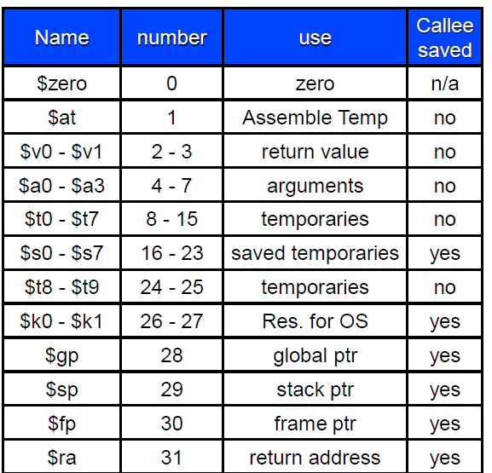

Slide 16
MIPS Registers and Usage
Each register can be referred to by number or name.

Slide 17
All register are same.
Where a register is needed, any register will work
By convention we use them for particular tasks.
$zero is the “zero register” which is always zero; writes to it have no effect.

Slide 18
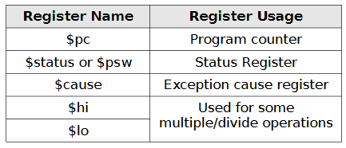
Miscellaneous Registers
In addition to the previously listed registers, there are some miscellaneous registers which are listed in the table:
The $pc or program counter register points to the next instruction to be executed and is automatically updated by the CPU after instruction are executed.
The $status or status register, also called $psw, is the processor status register and is updated after each instruction by the CPU.
The $cause or exception cause register is used by the CPU in the event of an exception or unexpected interruption in program control flow.
Examples of exceptions include division by 0, attempting to access an illegal memory address, or attempting to execute an invalid instruction (e.g., trying to execute a data item instead of code).
The $hi and $lo registers are used by some specialized multiply and divide instructions.
For example, a multiple of two 32-bit values can generate a 64-bit result, which is stored in $hi and $lo (32-bits each or a total of 64-bits).

Slide 19
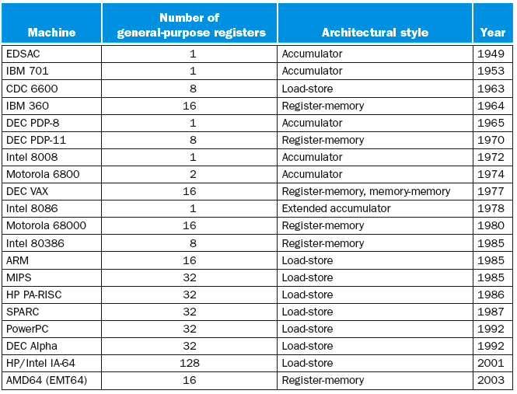
The number of available registers greatly influenced the instruction set architecture (ISA)
Notes:
The generalization of the dedicated-register architecture allows all the registers to be used for any purpose, hence the name general-purpose register. MIPS is an example of a general-purpose register architecture. This style of instruction set may be further divided into those that allow one operand to be in memory (as found in accumulator architectures), called a register-memory architecture, and those that demand that operands always be in registers, called either a load-store or a register-register architecture.
The 80386 is Intel’s attempt to transform the 8086 into a general-purpose register-memory instruction set. Perhaps the best-known register-memory instruction set is the IBM 360 architecture, first announced in 1964. This instruction set is still at the core of IBM’s mainframe computers—responsible for a large part of the business of the largest computer company in the world. Register-memory architectures were the most popular in the 1960s and the first half of the 1970s.
Digital Equipment Corporation’s VAX architecture took memory operands one step further in 1977. It allowed an instruction to use any combination of registers and memory operands. A style of architecture in which all operands can be in memory is called memory-memory. (In truth the VAX instruction set, like almost all other instruction sets since the IBM 360, is a hybrid, since it also has general-purpose registers.)
Digital Equipment Corporation’s VAX architecture took memory operands one step further in 1977. It allowed an instruction to use any combination of registers and memory operands. A style of architecture in which all operands can be in memory is called memory-memory. (In truth the VAX instruction set, like almost all other instruction sets since the IBM 360, is a hybrid, since it also has general-purpose registers.)

Slide 20
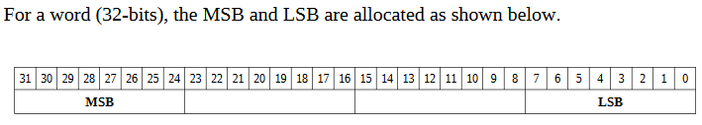
MEMORY
Memory can be viewed as a series of bytes, one after another.
Memory is byte addressable(each memory address holds one byte of information).
To store a word, four bytes are required which use four memory addresses.
The Least Significant Byte (LSB) is stored in the lowest memory address.
The Most Significant Byte (MSB) is stored in the highest memory location.

Slide 21
More about MIPS Memory Organization
Not all architectures require this
8 bits
32 bits
0x00000000
0x00000000
0
1
2
3
0x00000001
0x00000004
0x00000002
0x00000008
0x00000003
0x0000000C
*Word sizes vary in other architectures
Two views of memory:
2³² bytes with addresses 0, 1, 2, …, 2³²-1
2³⁰ 4-byte words* with addresses 0, 4, 8, …, 2³²-4
Both views use byte addresses
Word address must be multiple of 4 (aligned)

Slide 22
BYTE ADDRESSABLE vs WORD ADDRESSABLE

Slide 23
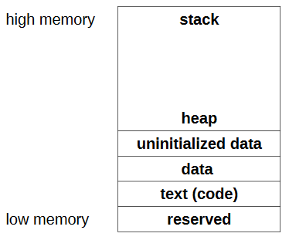
Memory Layout
The general memory layout for a program is as shown:
The reserved section is not available to user programs (for OS).
The text (or code) section is where the machine language (i.e., the 1's and 0's that represent the code) is stored.
The data section is where the initialized data is stored.
This include declared variables that have been provided an initial value at assemble time.
The uninitialized data section is where declared variables that have not been provided an initial value are stored.
If accessed before being set, the value will not be meaningful.
The heap is where dynamically allocated data will be stored (if requested).
The stack starts in high memory and grows downward.

Slide 24
MIPS Instruction Set
The instruction set consists of a variety of basic instructions, including:
21 arithmetic instructions (+, -, *, /, %)
8 logic instructions (&, |, ~, XOR)
8 bit manipulation instructions
12 comparison instructions (>, <, =, >=, <=, ¬)
25 branch/jump instructions
15 load instructions
10 store instructions
8 move instructions
4 miscellaneous instructions
https://en.wikipedia.org/wiki/MIPS_architecture

Slide 25
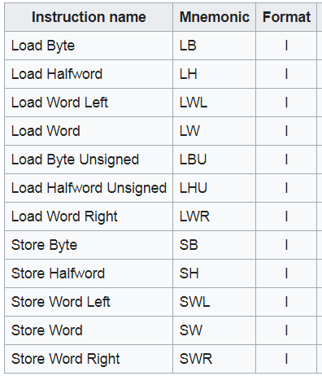
Loads and Stores

Slide 26
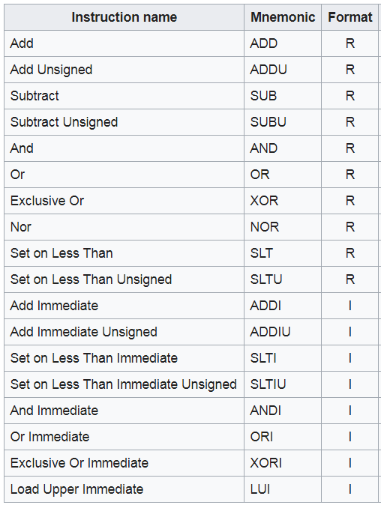
ALU
Notes:
These instructions source their operands from two GPRs (rs and rt), and write the result to a third GPR (rd).

Slide 27
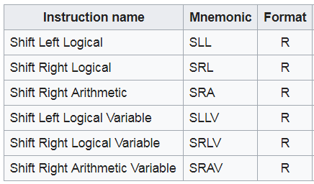
SHIFTS

Slide 28
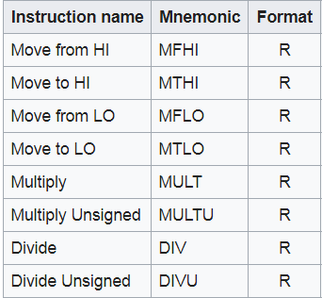
MULT and DIV

Slide 29
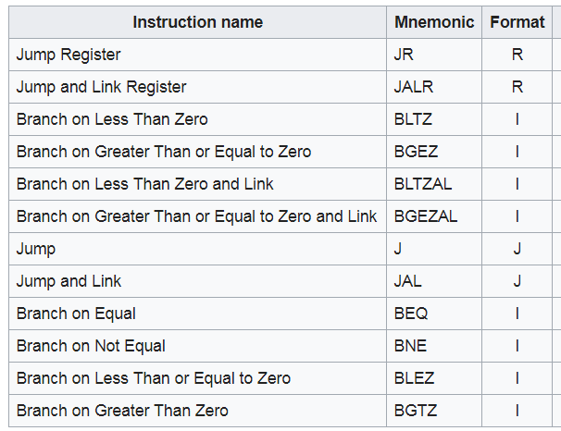
JUMP and BRANCH

Slide 30
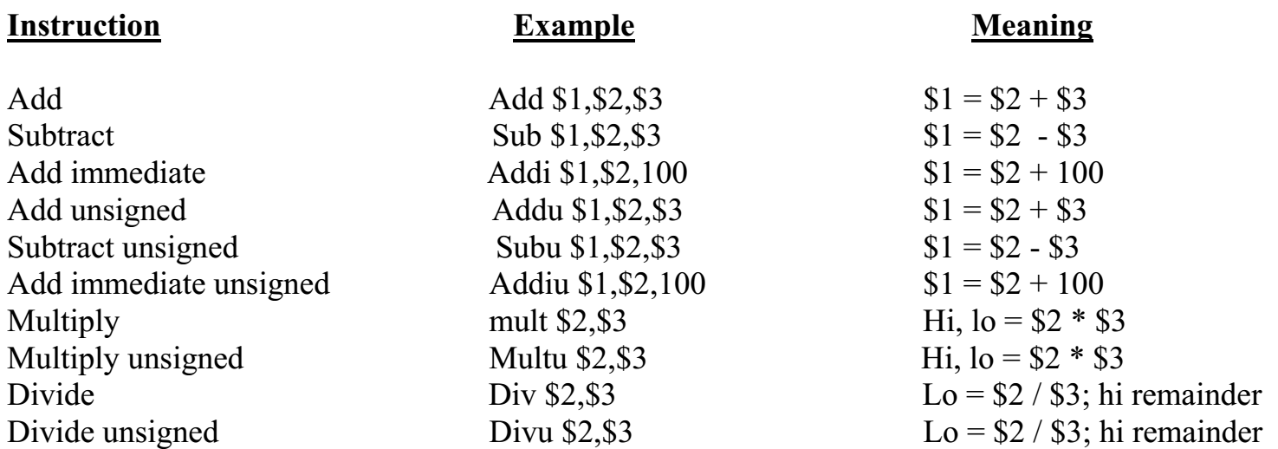

Slide 31
MIPS Instruction Types
R-type instructions, which perform arithmetic and logical operations on registers.
I-type instructions, which deal with load/stores and immediate literal values, as well as branches.
J-type instructions, which are used for jumps and function calls.

Slide 32
MIPS Instruction Types
Arithmetic & Logical - manipulate data in registers add $s1, $s2, $s3 $s1 = $s2 + $s3 or $s3, $s4, $s5 $s3 = $s4 OR $s5
Data Transfer - move register data to/from memory lw $s1, 100($s2) $s1 = Memory[$s2 + 100]; sw $s1, 100($s2) Memory[$s2 + 100] = $s1
Branch - alter program flow beq $s1, $s2, 25 if ($s1==$s1) PC = PC + 4 + 4*25

Slide 33
.data, .text, .globL Directives
.DATA directive
Defines the data segment of a program containing data
The program's variables should be defined under this directive
Assembler will allocate and initialize the storage of variables
.TEXT directive
Defines the code segment of a program containing instructions
.GLOBL directive
Declares a symbol as global
Global symbols can be referenced from other files
We use this directive to declare main procedure of a program

Slide 34
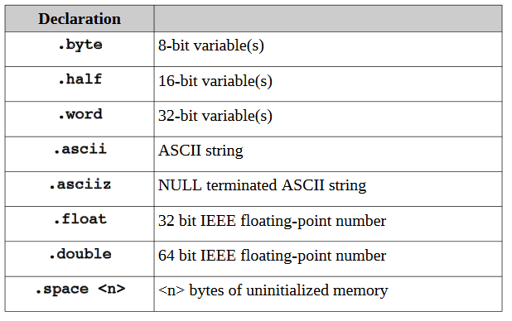
Data Declarations
The supported data types are as follows:
The data must be declared in the “.data" section.
All variables and constants are placed in this section.
Variable definitions must include the name, the data type, and the initial value for the variable.
In the definition, the variable name must be terminated with a ":".
The data type must be preceded with a "." (period). The general format is:
<variableName>: .<dataType> <initialValue>
wVar1: .word 500000
wVar2: .word -100000
hVar1: .half 5000
hVar2: .half -3000

Slide 35
String Data Declarations
Strings are a series of contiguously defined byte-sized characters, typically terminated with a NULL byte (0x00).
Strings are defined with .ascii or .asciiz directives.
message: .asciiz "Hello World\n"
Define a string with multiple lines, the NULL termination would only be required on the final or last line.
For example:
message: .ascii "Line 1: Goodbye World\n"
.ascii "Line 2: So, long and thanks "
.ascii "for all the fish.\n"
.asciiz "Line 3: Game Over.\n“

Slide 36
Program Code
The code must be preceded by the “ .text " directive.
Naming a "main" procedure:
The ".globl name" and ".ent name" directives are required to define the name of the initial or main procedure.
The main procedure (as all procedures) should be terminated with the ".end <name>" directive.
# Text/code section
.text
.globl main
main:
…
…
.end main

Slide 37
Pseudo-Instructions vs Bare-Instructions
The MIPS instruction set is very small, so to do more complicated tasks we need to employ assembler macros called pseudoinstructions.
A pseudo-instruction is an instruction that the assembler will recognize but then convert into one or more bare-instructions.
In MIPS architecture, the assembly language includes a number of pseudo-instructions, for example, blt, bgt, ble, neg, not, bge, li, la, move etc.
blt $8, $9, label
# A branch if less than pseudoinstruction translates to the following bare-instructions
blt $1, $8, $9
bne $1, $0, label
A bare-instruction is an instruction that is executed by the CPU.
li $8, 0x3BF20 # A load immediate value to a register translates to
lui $at, 0x0003
ori $8, $at, 0xBF20

Slide 38
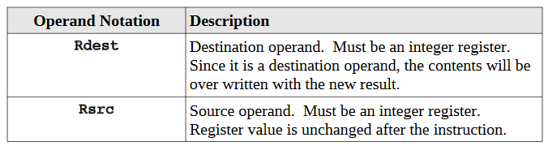
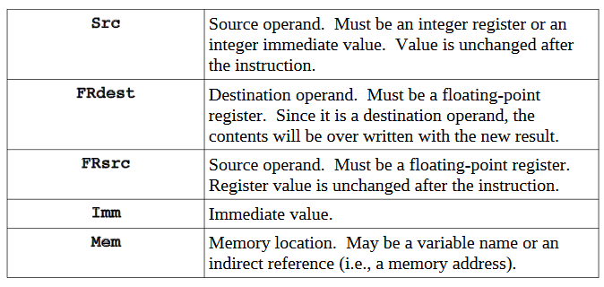
Notational Conventions

Slide 39
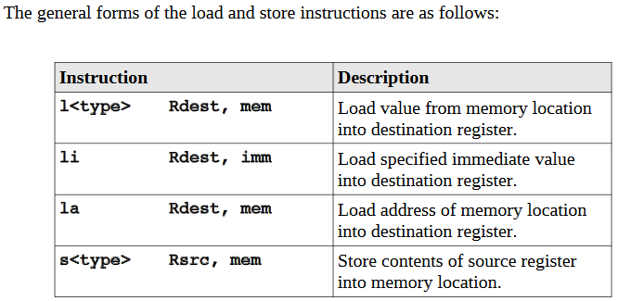

Slide 40
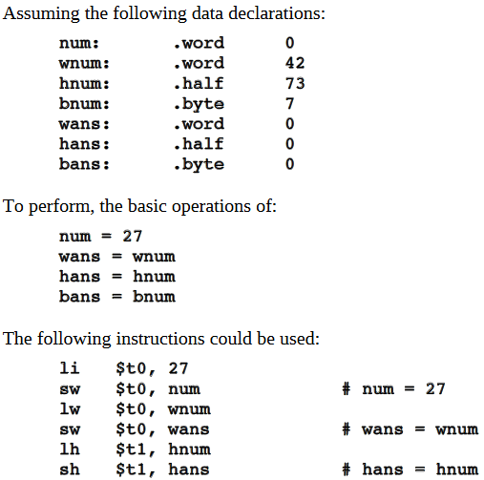
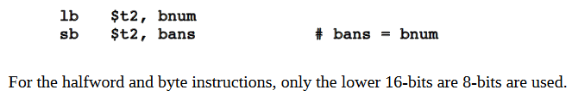

Slide 41
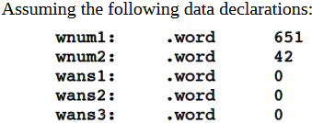
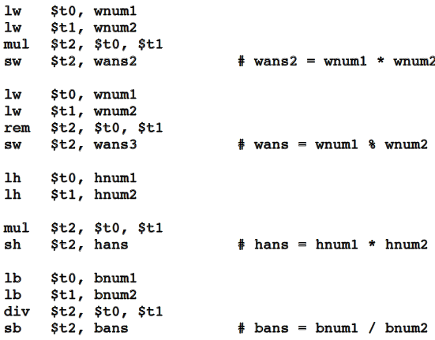
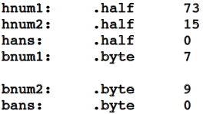
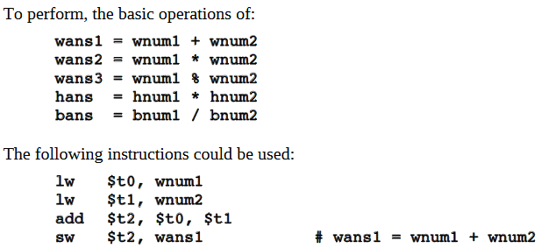

Slide 42

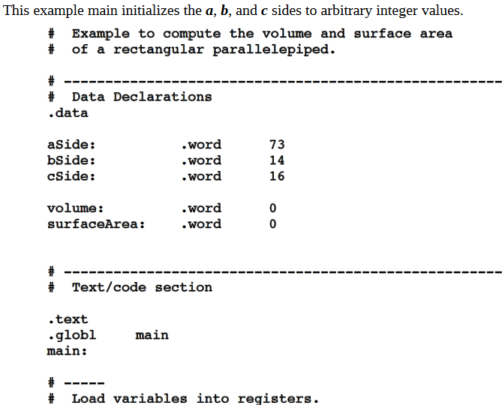
Example Program: Integer Arithmetic
Program to compute the volume and surface area of a rectangular parallelepiped.
The formulas for the volume and surface area are as follows:

Slide 43
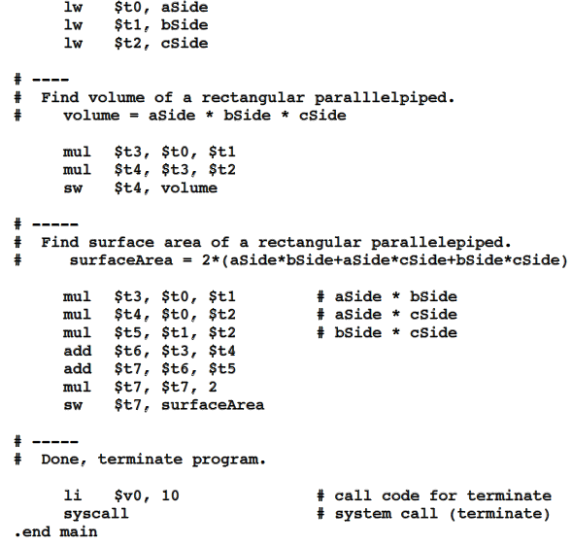

Slide 45
MIPS Instructions
All instructions exactly 32 bits wide
Different formats for different purposes
Similarities in formats ease implementation
0
6 bits
5 bits
5 bits
5 bits
5 bits
6 bits
31
op
rs
rt
rd
shamt
funct
0
R-Format
6 bits
5 bits
5 bits
16 bits
31
op
rs
rt
offset
I-Format
0
6 bits
26 bits
31
op
address
J-Format
http://max.cs.kzoo.edu/cs230/Resources/MIPS/MachineXL/InstructionFormats.html

Slide 46
Arithmetic & Logical Instructions - Binary Representation
6 bits
5 bits
5 bits
5 bits
5 bits
6 bits
Used for arithmetic, logical, shift instructions
op: Basic operation of the instruction (opcode)
rs: first register source operand
rt: second register source operand
rd: register destination operand
shamt: shift amount (more about this later)
funct: function - specific type of operation, function code (identifies the specific R-format instruction) (6 bits)
Also called “R-Format” or “R-Type” Instructions
op
rs
rt
rd
shamt
funct
31
0

Slide 47
Arithmetic & Logical Instructions - Binary Representation Example
Machine language for add $8, $17, $18
See reference card for op, funct values
6 bits
5 bits
5 bits
5 bits
5 bits
6 bits
op
rs
rt
rd
shamt
funct
31
0
0
17
18
8
0
32
Decimal
000000
10001
10010
01000
00000
100000
Binary

Slide 48
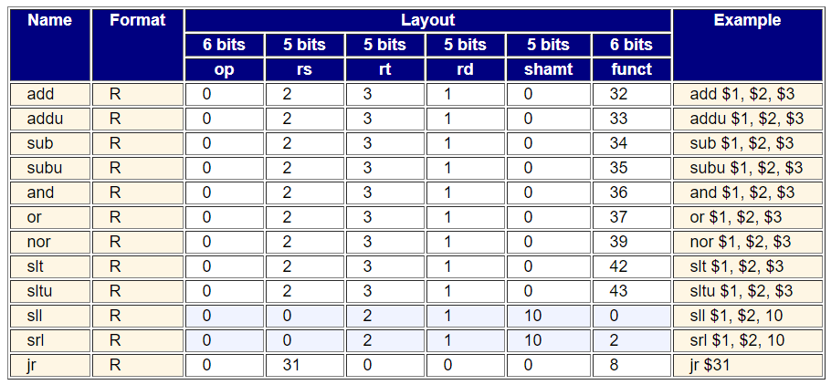
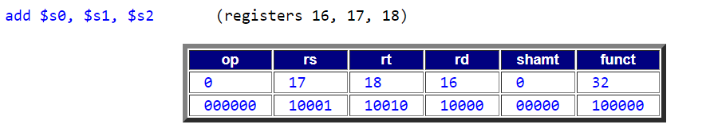

Slide 49
Data Transfer Instructions - Binary Representation
6 bits
5 bits
5 bits
16 bits
op
rs
rt
offset
Used for load, store instructions
op: Basic operation of the instruction (opcode)
rs: first register source operand
rt: second register source operand
offset: 16-bit signed address offset (-32,768 to +32,767)
Also called “I-Format” or “I-Type” instructions

Slide 50
Example - Loading a Simple Variable
8
R0=0 (constant)
0x00
R1
+
0x04
R2=0x10
0x08
R2=0x10
0x0c
R3
0x10
R4
0x14
Variable X
R5
R5
R5 = 692310
0x18
Variable Y
Variable Z = 692310
0x1c
Variable Z = 692310
R30
R31
Registers
lw R5,8(R2)
Memory

Slide 51
Data Transfer Example - Array Variable
12=0xc
Base Address
R0=0 (constant)
0x00
R1
+
0x04
R2=0x08
0x08
R2=0x08
0x0c
a[0]
R3
0x10
a[1]
R4
0x14
a[2]
R5=105
a[3]=105
R5=105
0x18
a[3]
0x1c
a[4]
R30
R31
Registers
C Program: int a[5];
a[3] = z;
Assembly: sw $5,12($2)
scaled offset
Memory

Slide 52
Branch Example
$19
$20
Machine language for beq $s3, $s4, L1 add $s0, $s1, $s2 L1: sub $s0, $s0, $s3
PC
PC+4
1-instruction
offset
Target
of beq
6 bits
5 bits
5 bits
16 bits
op
rs
rt
offset
31
0
4
19
20
1
Decimal
000100
10011
10100
0000000000000001
Binary

Slide 53
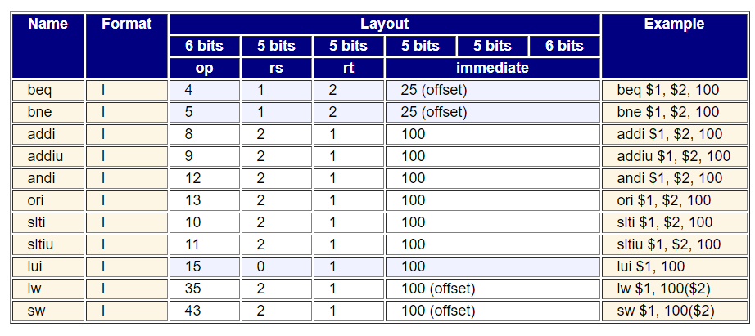
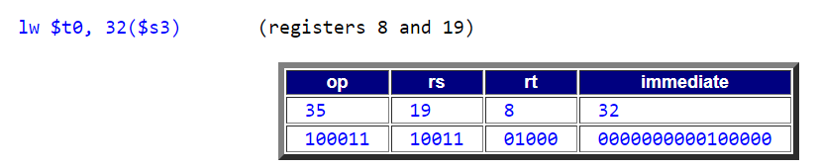

Slide 54
I-Format Example
Machine language for lw $9, 1200($8) == lw $t1, 1200($t0)
6 bits
5 bits
5 bits
16 bits
31
op
rs
rt
offset
0
35
8
9
1200
Decimal
100011
01000
01001
0000010010110000
Binary

Slide 55
Binary Representation - Branch
6 bits
5 bits
5 bits
16 bits
op
rs
rt
offset
Branch instructions use I-Format
offset is added to PC when branch is taken beq r0, r1, offset has the effect: if (r0==r1) pc = pc + 4 + (offset << 2) else pc = pc + 4;
Offset is specified in instruction words (why?)
What is the range of the branch target addresses?
Conversion to
word offset

Slide 56
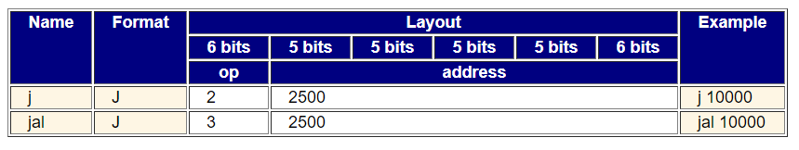

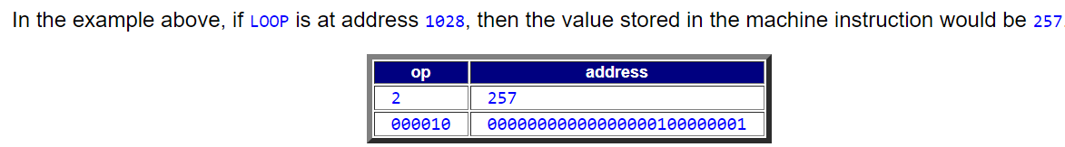

Slide 57
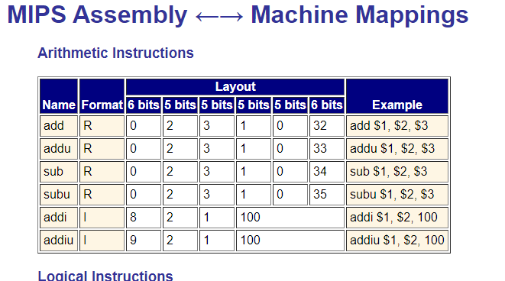

Slide 58
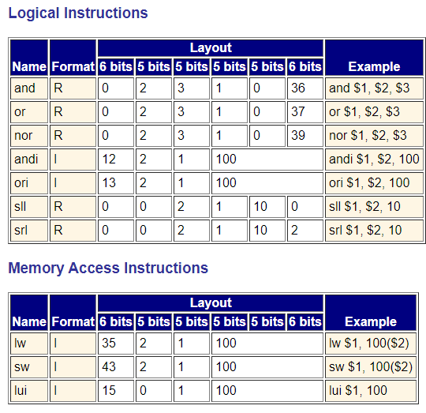

Slide 59
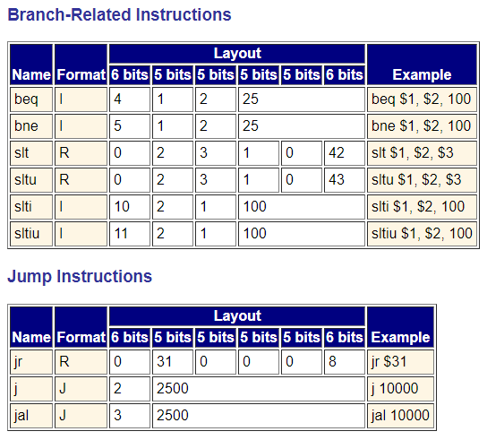

Slide 60
